Slide 1
CS 405 Final Project
Movie-Db
Dean Crockett, Jacob Pawlak,
Nick Reaves, and Connor VanMeter

Slide 2
Roles & Responsibilties
Dean Crockett: Frontend Web interface
Jacob Pawlak: Backend
Nick Reaves: Frontend/Backend collaboration
Connor VanMeter: Database Design; Database Schema; ER Diagram; Presentation; Final Report

Slide 3
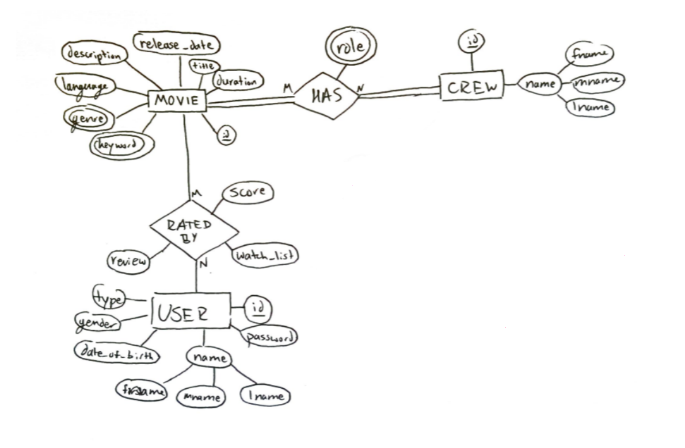
ER Diagram

Slide 4
Database Schema
Underline: primary attribute
Italics: multiple-value attribute
Entity: CREW
Attribute(s):
Crew_id
First_name
Middle_name
last_name
Relationship(s):
HAS: MOVIE
Review
wanted (yes/no)
Relates:
user <-> movie
Entity: USER
Attribute(s):
First_name
Middle_name
Last_name
Gender
dob (date of birth)
Type
User_id
password
Relationship(s):
RATES: MOVIE
Entity: MOVIE
Attributes(s):
Release_date
Title
Description
Movie_id
Duration
Language
Keyword
Genre
Relationship(s):
RATED BY: USER
HAS: MOVIE_CREW
Relationship: ROLES
Attribute(s):
role
Relates:
movie <-> crew
Relationship: RATING
Attribute(s):
value

Slide 5
Database Demonstration
Link:
Outline:

